Slide 1
CP4: Hotel Reservation
By Jordan Fleming

Slide 2
Goals for MVP
Allow user to register an account
Allow user to log in
Allow user to see all rooms available
Allow user to filter by prices
Allow user to book a room
Allow user to log out

Slide 3
Extra Features!
User is able to visit a profile page to see information about their account
User is able to see pages about the room and see more details about it

Slide 4
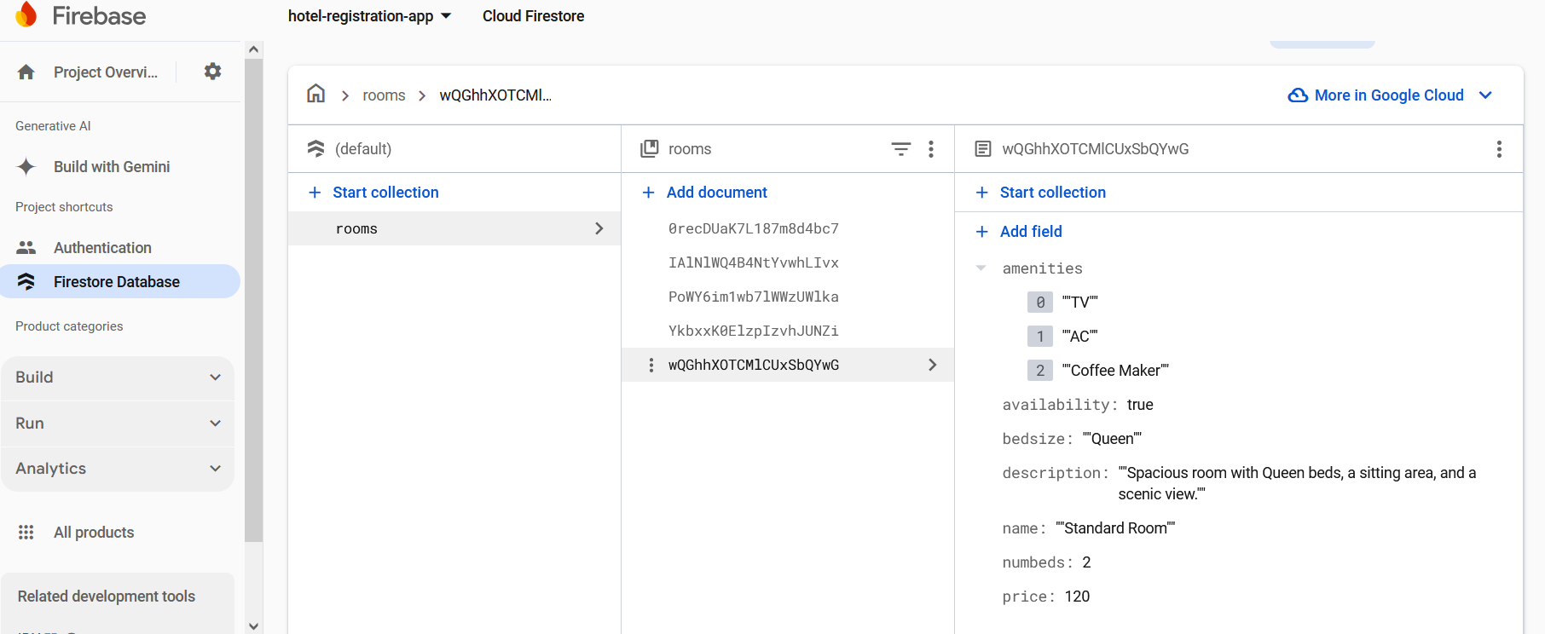
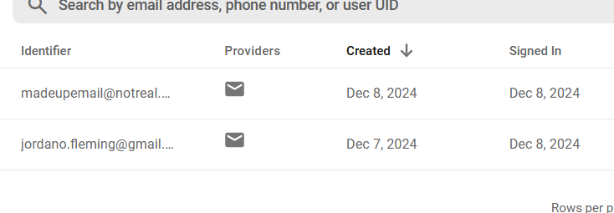
The use of Firebase
Firebase is used for hosting the database as well as user accounts/authorization.

Slide 5
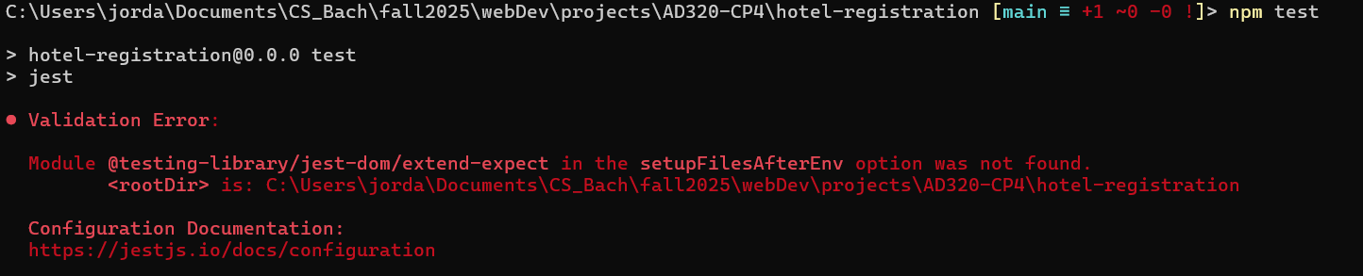
Testing
Do to being unable to solve the issue below after multiple days we unfortunately have 0% test coverage.

Slide 6
Plans for the future!
Goals I would like to hit are:
Making a protected admin route for easy database manipulation.
Heavily updating CSS
Fixing bug with availability not updating
Adding visuals to show when rooms are not available for check out.
Add pictures of rooms with image carousel.
Vastly improve booking logic in general to add date ranges

Slide 7
Thanks
I want to take the time to thank everyone who has supported me this quarter with everything going on. This has been a very trying time in my life but thank you:
My dogs Izaya and Eevee
My partner Bri, her dog Pandora, and cat Grayson
My professor Eric
My team in project management Justin, Nikki, and Aaron
And my work for being flexible
I look forward to getting to push myself more in the future and hope I will have the space and bandwidth to allow myself to shine more.

